Slide 1
Post covid-19
MTA Ridership Analysis
BY:
ISMAIL MALIK AKANFE
May, 2025

Slide 2
Introduction
The Metropolitan Transportation Authority (MTA) is the backbone of public transport in New York, connecting 12 counties in the southeastern part of the state. It also serves two counties in southwestern Connecticut under a contract with the Connecticut Department of Transportation (CDOT). As the largest transportation network in North America, the MTA keeps millions moving every day.
This in-depth analysis delves into the post-pandemic ridership landscape, uncovering key trends, behavioral shifts, and emerging patterns in travel. By exploring real-time data, forecasting future demand, and assessing transit adaptation strategies, we gain valuable insights into how public transportation is evolving and what lies ahead for the city's dynamic transit ecosystem.

Slide 3
Content
Objectives
Key Notes
Ridership Overview
Daily Trend
Monthly Trend
Forecast
Conclusion & Recommendation
Dashboards

Slide 4
Objectives
Tracking ridership trends in different sectors over time.
Identifying patterns and connections between sectors.
Forecasting for future demands.
Using insights to shape decision to advocate for future demand.

Slide 5
Key Notes
Access-A-Ride (AAR) provides transportation for eligible riders with disabilities who can't use buses or subways, ensuring accessibility under the Americans with Disabilities Act (ADA).
MTA Bridges and Tunnels (B&T) manages seven bridges and two tunnels in NYC and oversees the Central Business District Tolling Program (CBDTP).
Bus service within New York City is operated by MTA agencies New York City Transit (NYCT) and MTA Bus Company (MTABC).
The Long Island Rail Road (LIRR) is North America's busiest commuter railroad, connecting Manhattan to Suffolk County on Long Island.
The Metro-North Railroad (MNR) connects Manhattan to the Bronx, Hudson Valley, and Connecticut, making it North America's second-busiest commuter rail.
The MTA Staten Island Railway (SIR) is Staten Island’s only rapid transit line, running 24/7 between St. George and Tottenville, with ferry connections to Manhattan.
Subway service within New York City is operated by MTA New York City Transit (NYCT).

Slide 6
Ridership Overview
Timestamp
From 1st of March 2020 to 31st of Oct 2024
8billion
Total ridership across all sectors
664 thousand
Average Daily Travel across all sectors
62.5%
Average percentage Change across all sectors

Slide 7
Daily Trend
The dashboards reveal a clear trend: weekday ridership is significantly higher across all sectors compared to weekends. This pattern highlights the impact of work schedules, commuting habits on public transportation demand throughout the week.
On weekdays, people rely heavily on transit for commuting to work, school, and daily activities, driving up ridership numbers.
Weekends, on the other hand, see a shift toward leisure travel, resulting in lower overall ridership across different sectors.
This insight is crucial for optimizing transit schedules, managing capacity, and ensuring efficient resource allocation to meet demand fluctuations throughout the week.

Slide 8
Monthly Trend
The data showcases a consistent upward trend in monthly ridership across all sectors, reflecting growing demand for public transportation. This increase suggests multiple contributing factors, including post pandemic economic recovery, evolving travel behaviors, increased commuter confidence, and improvements in transit accessibility.
As routine travel, work commutes, and leisure trips rebound from the pandemic effect, optimizing schedules, expanding infrastructure, and enhancing services become crucial for future growth.

Slide 9
Forecast
The monthly trend highlights a steady increase in demand, and systematic forecasting reinforces this outlook with a projected upward trajectory for the next three years. This growth is influenced by multiple factors, including economic recovery, expanding urbanization, evolving commuter preferences, and improvements in transit infrastructure. As populations grow and mobility needs shift, public transportation becomes even more essential for efficiency, sustainability, and connectivity.

Slide 10
CONCLUSION AND RECOMMENDATION
With ridership expected to rise, optimizing scheduling, capacity planning, and service expansion will be key to accommodating future demand.
Transit authorities, policymakers, and urban planners must use these insights to develop data-driven strategies, ensuring that public transportation remains accessible, reliable, and adaptable to changing patterns.

Slide 11
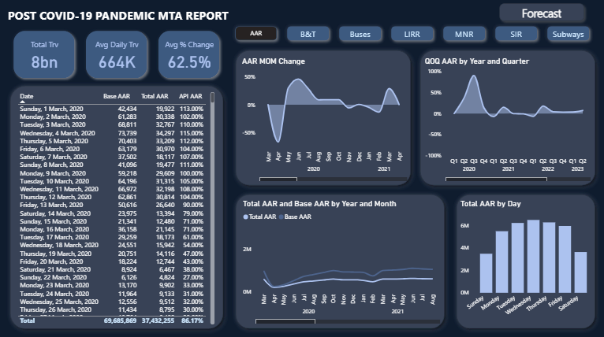

Slide 12
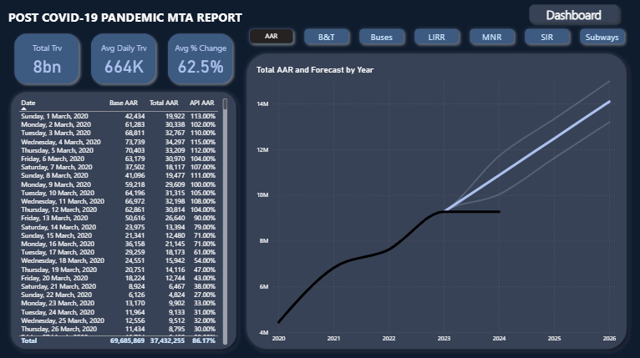

Slide 13
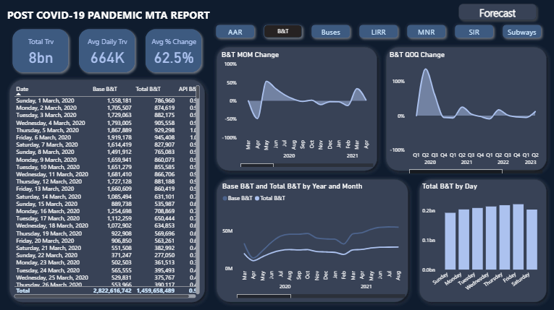

Slide 14
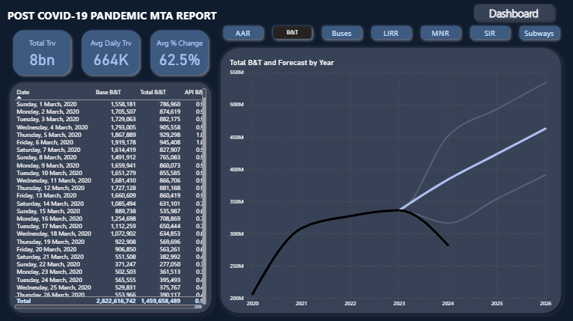

Slide 15
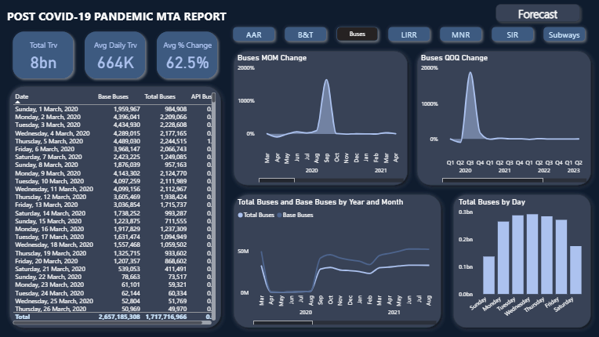

Slide 16
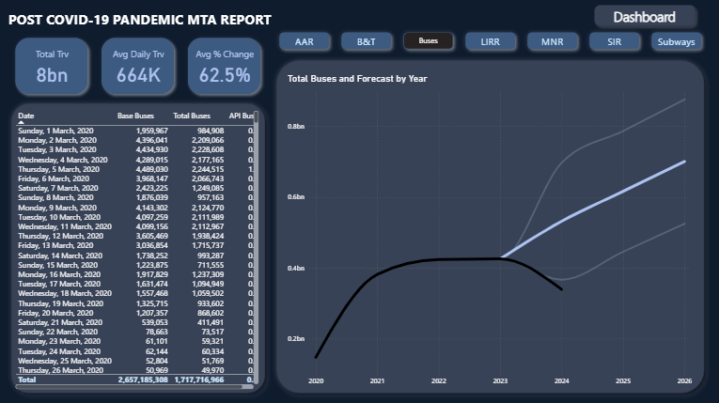

Slide 17
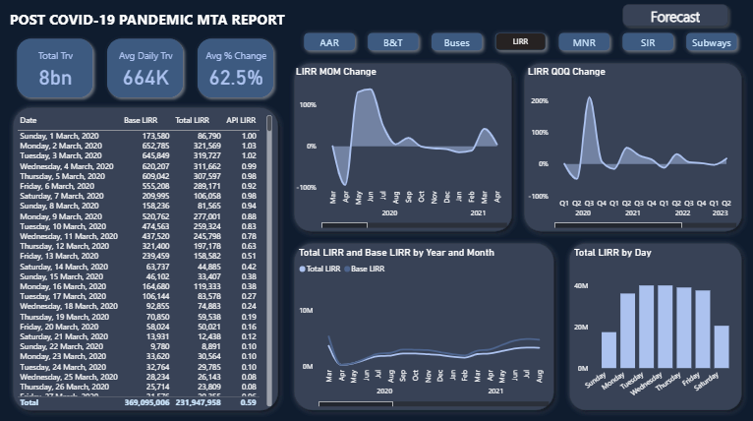

Slide 18
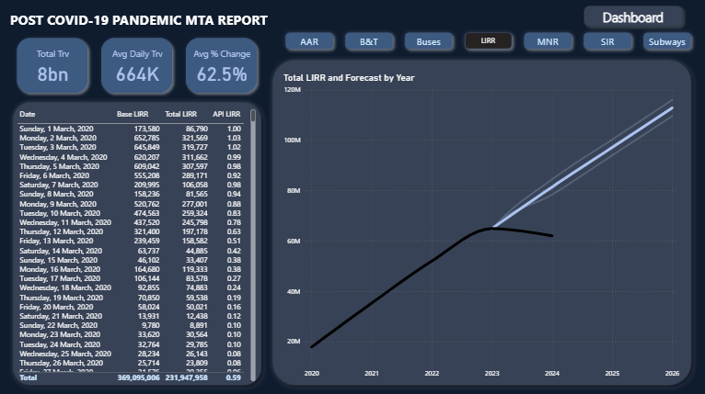

Slide 19
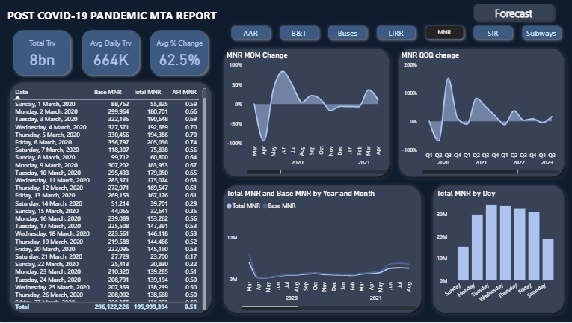

Slide 20
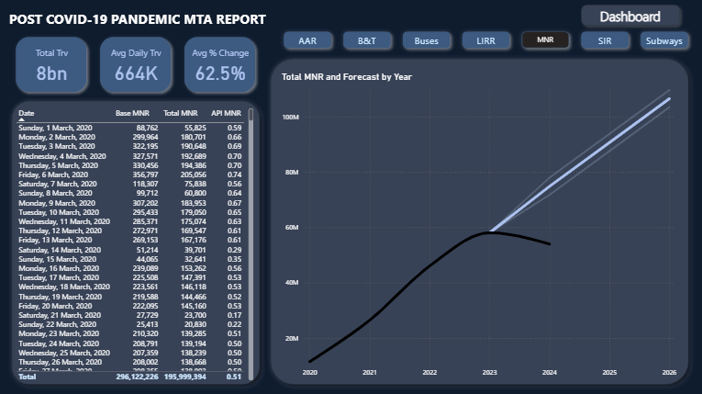

Slide 21
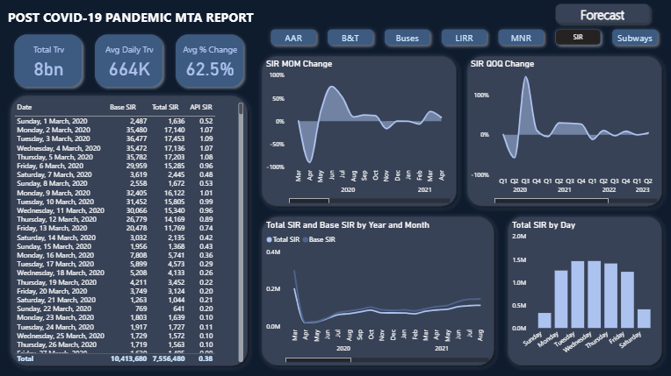

Slide 22
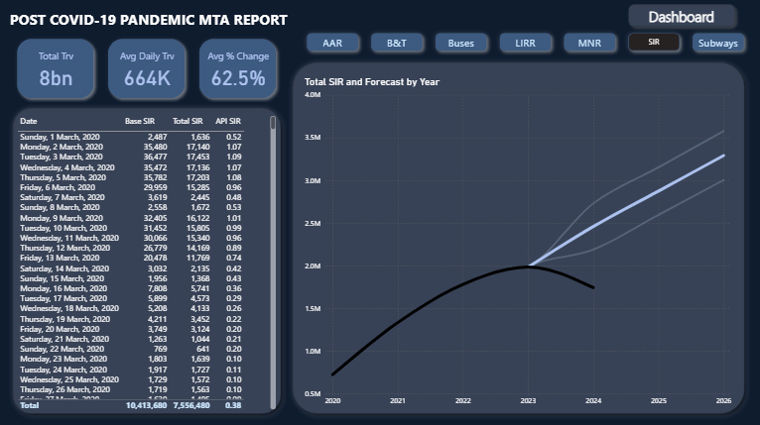

Slide 23
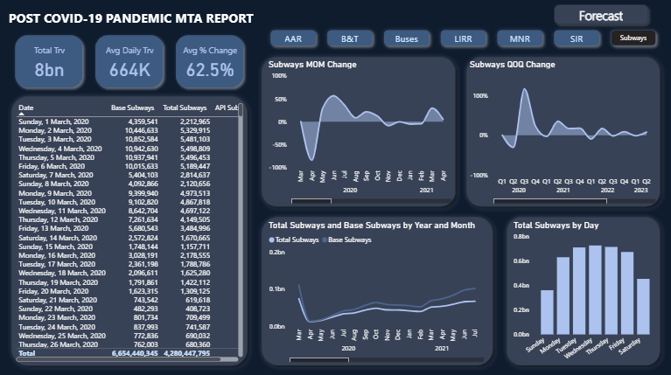

Slide 24
